Slide 1
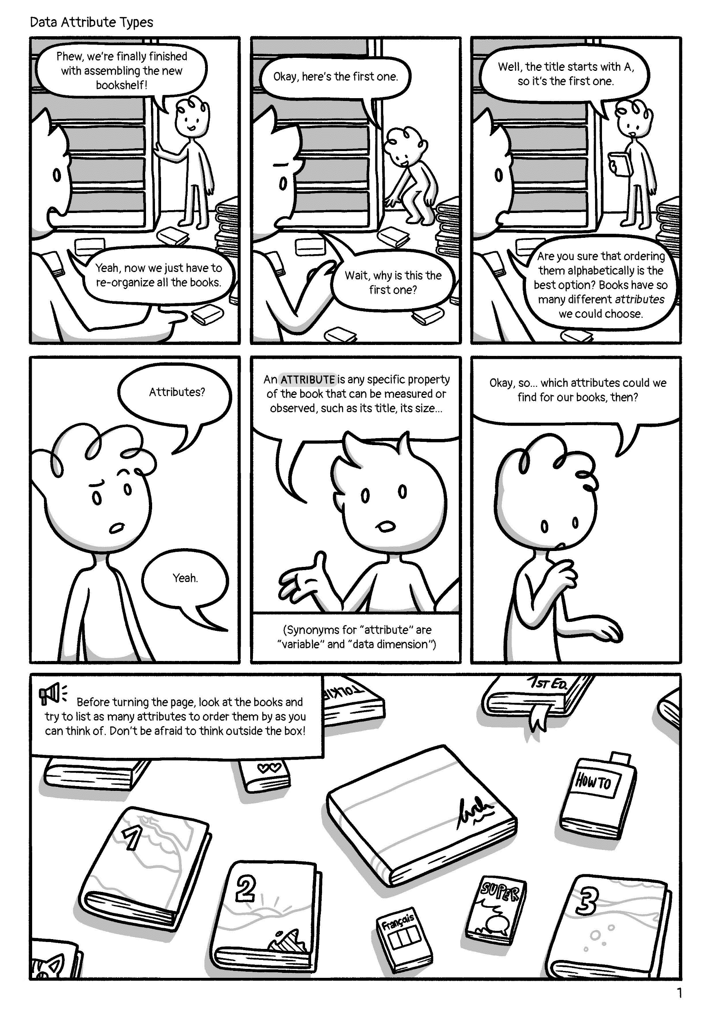
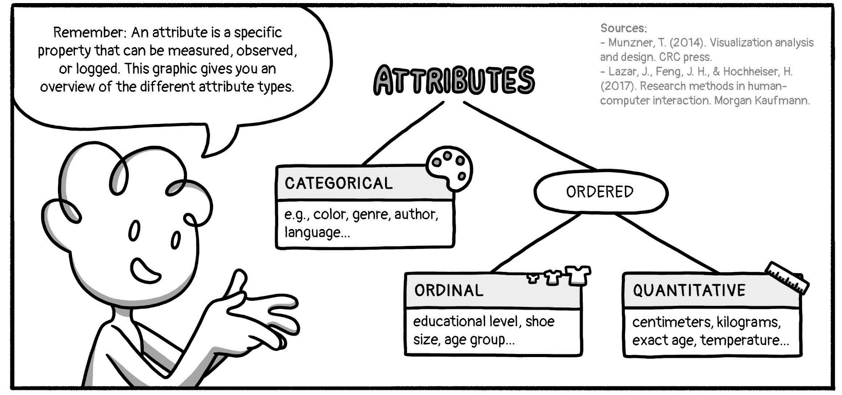

In general:
Attribute Types © 2022 by Comixplain
https://fhstp.github.io/comixplain

